Slide 1
Lecture 13: Convex optimization, special cases

Slide 2
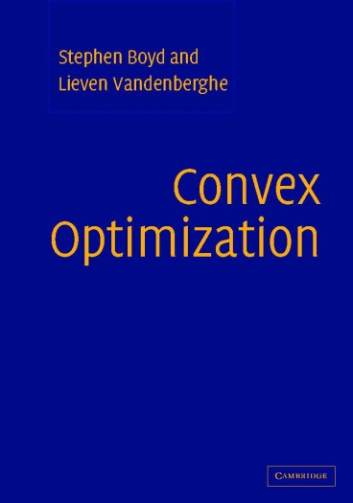
Today’s reading

Slide 3
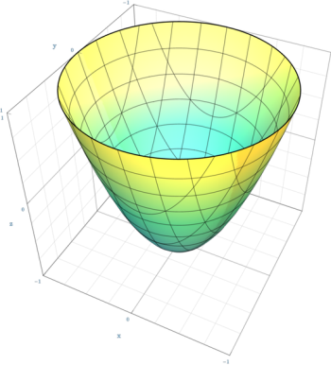
Convex programming
Convex objective
“minimize”
“subject to”
Convex domain

Slide 4
Linear program

Slide 5
Overhead view

Slide 6
Overhead view
Notes:
Unbounded case, optimal value = -inf

Slide 7
Overhead view
Notes:
Infeasible case, optimal value = +inf

Slide 8
Convex Quadratic Program
Positive
Semi-definite
QP = quadratic objective + linear constraints

Slide 9
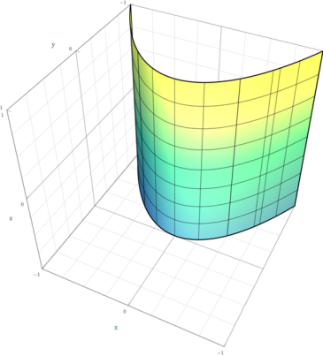
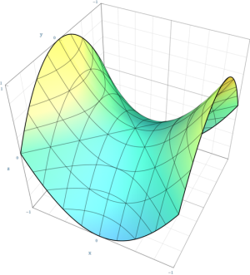
Reminder: quadratic functions
positive definite
indefinite
negative semi-definite
Images from Wikipedia
Notes:
Draw the axes
Say that in high dimensions, most quadric functions are indefinite.
Point out that convex function has a single minimum

Slide 10
Overhead view

Slide 11
Overhead view

Slide 12
Overhead view

Slide 13

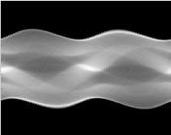
Reminder: least squares
=
+
NOISE
SINOGRAM
CT IMAGE

Slide 14
Constrained least squares
=
+
NOISE
SINOGRAM
CT IMAGE

Slide 15
Regularized empirical risk minimization
annotated examples we learn from
parameters we learn
our prediction
Regularization: doing not much worse on other examples
Empirical risk: doing well on training examples

Slide 16
Regularized empirical risk minimization
Example 1: regression
Not really suitable for classification…

Slide 17
Learning to classify

Slide 18
Learning to classify with the hinge loss
SVM QP:

Slide 19
Geometric interpretation for hinge loss
SVM:
Maximizes 1/||w||
Minimizes slacks
?
SVM QP:

Slide 20
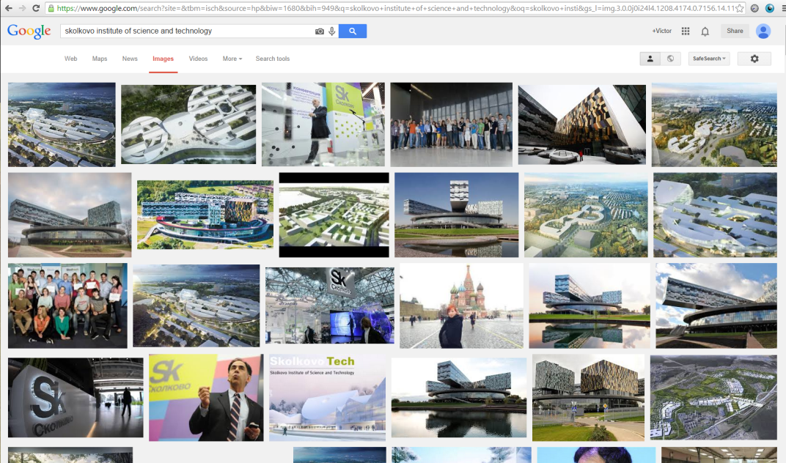
Learning to rank

Slide 21
Learning to Rank
training sample
joint feature mapping
parameters we learn
our prediction for the relevance
Main idea: learn based on pairs

Slide 22
Learning to Rank
training sample
joint feature mapping
parameters we learn
our prediction for the relevance

Slide 23
Rank-SVM

Slide 24
Learning to rank
constraints
Constraint-generation (cutting plane) methods
Stochastic subgradient…

Slide 25
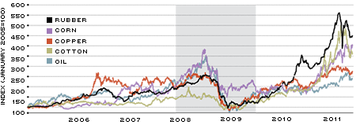
Markowitz portfolio optimization
Task: invest a certain amount of money into multiple bonds/commodities
Objective: achieve a certain expected return, minimize risk

Slide 26
Markowitz portfolio optimization
change in prices over the next years
assuming Gaussian distribution
my portfolio
my return
portfolio QP:

Slide 27
Second-order convex cone programming
Generalizing LP by adding a special cone constraint
Very efficient solvers, e.g. SeDuMi exist

Slide 28
From QP to SOCP
SOCP
QCQP
QP
LP

Slide 29
Robust linear programs

Slide 30
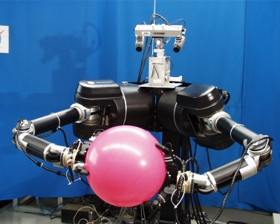
Grasping robot
image from Lab for Perceptual Robotics@UMass
External force (e.g. gravity)
Force from each finger (orthogonal to surface)
Static friction force at each finger (tangential to surface)
Optimize finger forces to held object

Slide 31
Grasping robot
external force
external torque

Slide 32
Grasping robot
Grasping robot SOCP

Slide 33
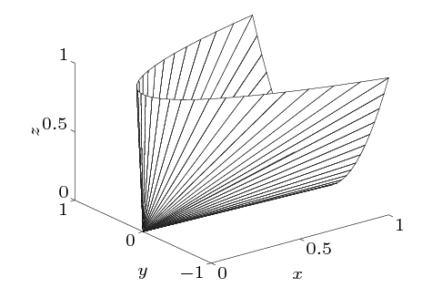
Semidefinite programming
Multiple SDP constraints can be stacked in a block-diagonal way
E.g. expressing the linear constraints in SDP:

Slide 34
Example: non-linear SDP

Slide 35
Example: expressing SOCP as SDP

Slide 36
Semidefinite programming
Applications:
structural design
geometric problems (e.g. finding optimal ellipsoids)
relaxation of binary problems (coming tomorrow)

Slide 37

Nested doll of Convex Optimization
SDP
SOCP
QCQP
QP
LP

